Slide 1


EU International Partnerships in Asia-Pacific
Jean-Christophe Virieu
European Commission
Directorate General for International Partnerships (INTPA)

Slide 2
Implementing EU Policies and strategies
Delivering on Global commitments
2030 Agenda for Sustainable development
European Consensus on Development – 2017
The Paris Agreement on Climate Change
Global Gateway
EU strategy for cooperation in the Indo Pacific
Fostering EU engagement
Global Europe: The Neighbourhood, Development and International Cooperation Instrument

Slide 3

Notes:
On 1 December 2021, the Joint Communication on Global Gateway was released. Global Gateway is the European Union’s offer to partner countries to accelerate their twin transitions. It provides them with a sustainable plan to respond to their infrastructure needs. It will be anchored in the 2030 Agenda for Sustainable Development and the Paris Agreement. It builds on the achievements of the 2018 EU-Asia Connectivity Strategy.

Slide 4
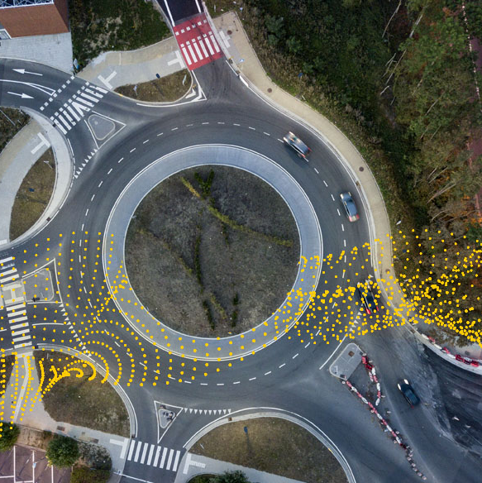

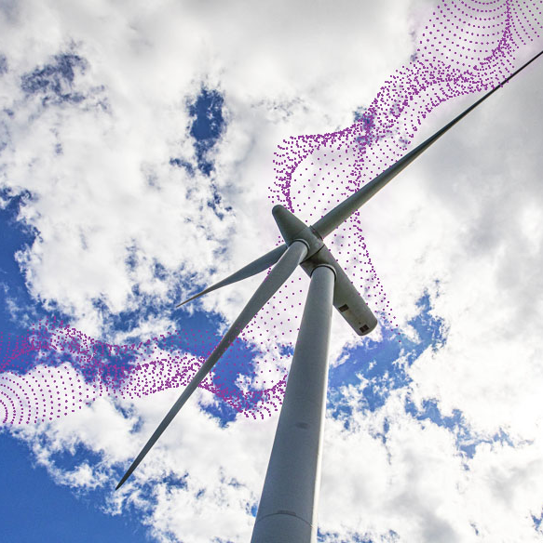
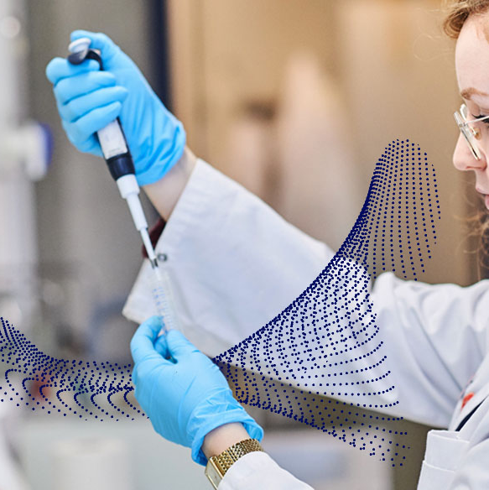
Global Gateway
Investment priorities
Climate & energy
Digitalisation
Transport
Health
Education & research
Physical infrastructure
Regulatory environment
Soft skills
Notes:
Global Gateway will focus on infrastructure that responds to the various current challenges and be framed in the geopolitical context. It will be anchored in five policy drivers: (1) digitalisation, (2) climate and energy, (3) transport, (4) health, as well as (5) education and research. It will not just be based on physical sustainable infrastructure, but also on soft skills and regulatory environments.
Digital.
The EU will support open and secure internet
Climate and energy.
The EU will support investments and rules paving the way to the clean energy transition
Transport.
The EU will support all modes of green, smart and safe transport
Health.
The EU will help strengthen supply chains and local vaccines production
Education and Research.
The EU will invest in high quality education, with a special focus on girls and women and vulnerable groups

Slide 5






Global Gateway
Key guiding principles for investments
Democratic values and high standards
Good governance and transparency
Equal
partnerships
Green and clean
Security
focused
Catalysing private
sector investment

Slide 6
The EU Strategy for Cooperation
in the Indo Pacific

Slide 7
The EU’s approach - A set of ambitious policy goals
2
Contribute to achieving the SDGs, to addressing climate change and environmental degradation, and to supporting sustainable and inclusive development
4
1
3
Engage in bilateral and multilateral cooperation with partners to meet the objectives of the Paris Agreement and the Convention on Biological Diversity (CBD)
Promote a level playing field and an open and fair environment for trade and investment
Solidify and defend the rules-based international order
5
6
7
8
Pursue long-standing multilateral and regional cooperation with the UN and Bretton Woods Institutions, as well as regional organizations such as ASEAN
Support truly inclusive policy-making and cooperation, where the voices of civil society, the private sector, social partners and other key stakeholders count
Establish mutually supportive trade and economic relations with the region that foster inclusive economic growth and stability, and promote and facilitate connectivity
Engage in the region as a partner in our efforts to raise awareness on the impact of global demographic trends
Notes:
Source image: EU China Factsheet 2020 [https://eeas.europa.eu/sites/eeas/files/eu-china_factsheet_06_2020_0.pdf]

Slide 8
The EU’s approach – Priority areas
I
II
III
IV
V
VI
VII
Sustainable and Inclusive Prosperity
Digital Governance and Partnerships
Green Transition
Ocean Governance
Connectivity
Security and Defence
Human Security
Reinforce value chains and develop cooperation in strategic sectors
Strengthen rules to protect international trade against unfair practices
Work with partners to fight, mitigate and adapt to climate change and to counter environmental degradation
Strengthen ocean governance
Support partners to fight against IUU fishing and to implement Sustainable Fisheries Partnership Agreements
Expand the network of digital partnerships and explore potential new Digital Partnership Agreements
Strengthen cooperation under “Horizon Europe” program
Support partners to establish a good regulatory environment and facilitate funding to improve connectivity on the ground between Europe and the Indo-Pacific
Promote an open and rule-based regional security architecture
Explore ways to ensure enhanced naval deployments by EU MSs
Support I-P partners’ capacity to ensure maritime security
Facilitate capacity-building for partners to tackle cybercrime
Support healthcare systems and pandemic preparedness for the least-developed countries in the Indo-Pacific region
Reinforce the EU’s disaster risk reduction and preparedness
Notes:
Source image: EU China Factsheet 2020 [https://eeas.europa.eu/sites/eeas/files/eu-china_factsheet_06_2020_0.pdf]

Slide 9
Fostering EU engagement:
Financing the External Action of the European Union

Slide 10
Global Europe: The Neighbourhood, Development and International Cooperation Instrument (NDICI)
NDICI mobilises a total financial envelope of EUR 79.462 billion over the 2021-2027 period through three key pillars :
Geographical: European Neighborhood, Sub-Saharan Africa, Asia and the Pacific and the Americas and the Caribbean
> EUR 8.5 billion for the Asia-Pacific region
Thematic: Focus on human rights and democracy, civil society, stability and peace, as well as on global challenges such as health and climate change
Rapid Response: Peace, stability and conflict prevention ; resilience and linking humanitarian aid and development action ; Union foreign policy needs and priorities

Slide 11
Multi-Annual Indicative Programme
BANGLADESH – Priorities 2021-2027
HUMAN CAPITAL
DEVELOPMENT
GREEN INCLUSIVE DEVELOPMENT
INCLUSIVE
GOVERNANCE
Quality education and life-long learning
Youth employment
Decent work and social protection
Energy efficiency and renewable energy
Environmental protection and climate change
Fight against gender-based violence
Access to justice for marginalized groups
Financial & Fiscal management
Digital governance for service delivery and finance
Mainstreaming cross cutting issues

Slide 12
Regional Indicative programme for Asia-Pacific
Regional integration and cooperation
Central Asia
South Asia
South East Asia and ASEAN
Pacific
Pan-Asia
  Partnering for resilience
  Water and energy
Human rights, women’s empowerment, rule of law and support to civil society
Integrated approach to peace and stability
  Sustainable and resilient environment
  Implementing EU-ASEAN partnership
  Policy dialogue
  Global challenges and BBB
  Regional integration
  Climate action and environmental sustainability
  International partnerships across Asia, Pacific and the Middle East in pursuit of the EU’s external priorities
  MSMEs equipped for global trade and EU-Asia resilient and sustainable value chains, sustainable consumption and production, circular business models
  Strong cultural ties between Europe and Asia
  Trade, Energy and Digital Connectivity
  Inclusive Economic Development
  Integrated approach for regional stability and conflict prevention
  Green Alliance
  Fundamental Values, Human Development, Peace and Security
  Partnering for prosperity
  Digital connectivity
  Entrepreneurship and regional trade
  Human development
  Sustainable connectivity

Slide 13
Regional Indicative programme for Asia-Pacific Pursuing EU interests with key partners
China
India
Gulf countries
Asian partners
Promote European values and interests in bilateral relations
Global public goods, global challenges and international commitments including the Agenda 2030 and the Paris Agreement
China’s role as global actor and emerging donor, international norms and standards
Green Deals
Climate change mitigation and adaptation
Biodiversity
Clean energy transition
Resource efficiency/circular economy
Urban development
  Political and policy dialogue at national and regional level
Cooperation with like-minded countries in Asia to strengthen multilateralism
Promotion and projection of EU policies and standards
Economic diplomacy: FTAs, level playing field, market access, investment, business opportunities
Supporting key political processes, tools and objectives between the EU and Asian High Income Countries and other key partners
Enhance EU’s profile as global actor in the Asia-Pacific through Public Diplomacy and Principles
Sectoral cooperation
Sustainable Growth
Health
Digital agenda/transformation
Mobility
Connectivity
Support to green, digital and innovative EU businesses
Trade
Intra-regional cooperation
Governance, People, Peace, Security
Security
Migration and mobility
CSO engagement

Slide 14

SWITCH-Asia Programme
Promoting Sustainable Consumption and Production (SCP)
Our Programme in a nutshell
How do we work
Launched in 2007, covering 30+ countries across Asia, the Middle-East and the Pacific (these 2 last regions since 2022).
Its mission: support the transition of the region to a low-carbon, resource efficient and circular economy, whilst promoting more sustainable supply chains and products between the region and Europe.
Economic sectors: agri-food, textiles and leather, plastics, constructions, tourism, logistic and freight, electronics, etc.
EU policy alignment: support the implementation of the external dimension of the EU Green Deal (Circular Economy Action Plan, Farm to Fork Strategy, EU Strategy for Textiles, EU Plastics Strategy)
At project level - Through its Grant Scheme, the Programme supports collaborative projects between European and PanAsian organisations aiming at testing and uptaking SCP practices in MSMEs and among consumers (at date: ca. 150 projects).
  Strong future priority: ensure linkages with IFIs to provide access to finance to MSMEs to integrate tested SCP solutions.
At policy level - The outcomes of projects feed into policy dialogue to influence national policies and regulatory frameworks for the promotion of a greener and more circular economy in the region.
Coordination mechanism with focal points in our EU Delegations and in each government in the region. Strong collaboration with regional environmental platforms and organisations.
Programme Coordinator: Alessandra.LEPORE@ec.europa.eu

Slide 15
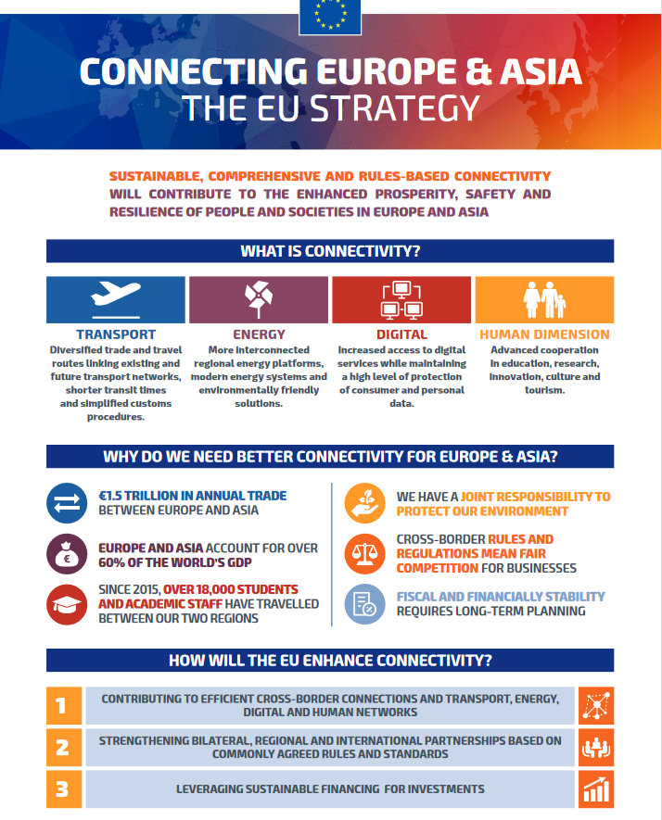
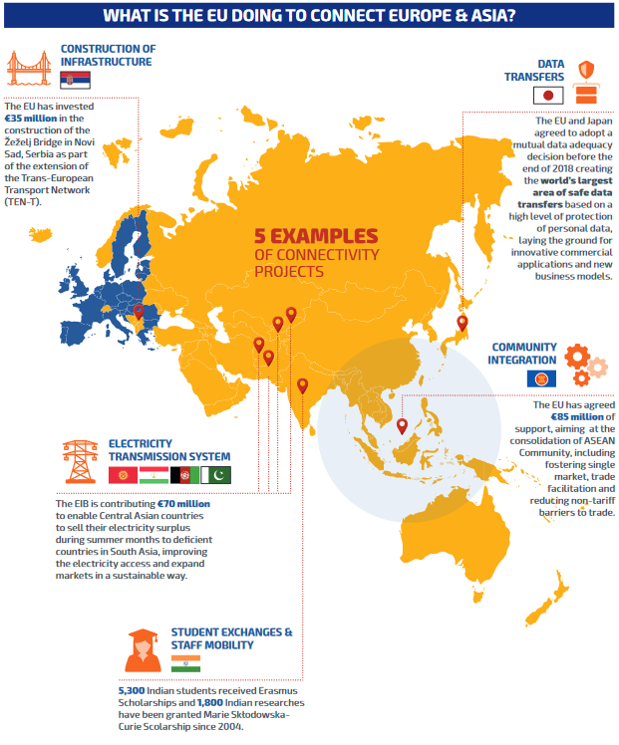

Slide 16
Links & E-mail
Global Europe programming: https://ec.europa.eu/international-partnerships/global-europe-programming_en
EU Strategy in the Indo Pacific: https://ec.europa.eu/commission/presscorner/detail/en/QANDA_21_4709
Global Gateway: https://ec.europa.eu/info/strategy/priorities-2019-2024/stronger-europe-world/global-gateway_en
SWITCH Asia: http://www.switch-asia.eu/
Horizon Europe: Research and innovation funding programme until 2027: https://ec.europa.eu/programmes/horizon2020/en/area/international-cooperation
E-mail: jean-christophe.virieu@ec.europa.eu / SWITCH: Alessandra.LEPORE@ec.europa.eu
© European Union 2022
Notes:
Update/add/delete parts of the copy right notice where appropriate.
More information: https://myintracomm.ec.europa.eu/corp/intellectual-property/Documents/2019_Reuse-guidelines%28CC-BY%29.pdf

