Slide 1
Máté Csicsai Team Leader for Eastern Partnership Coordination DG NEAR, European Commission

Slide 2
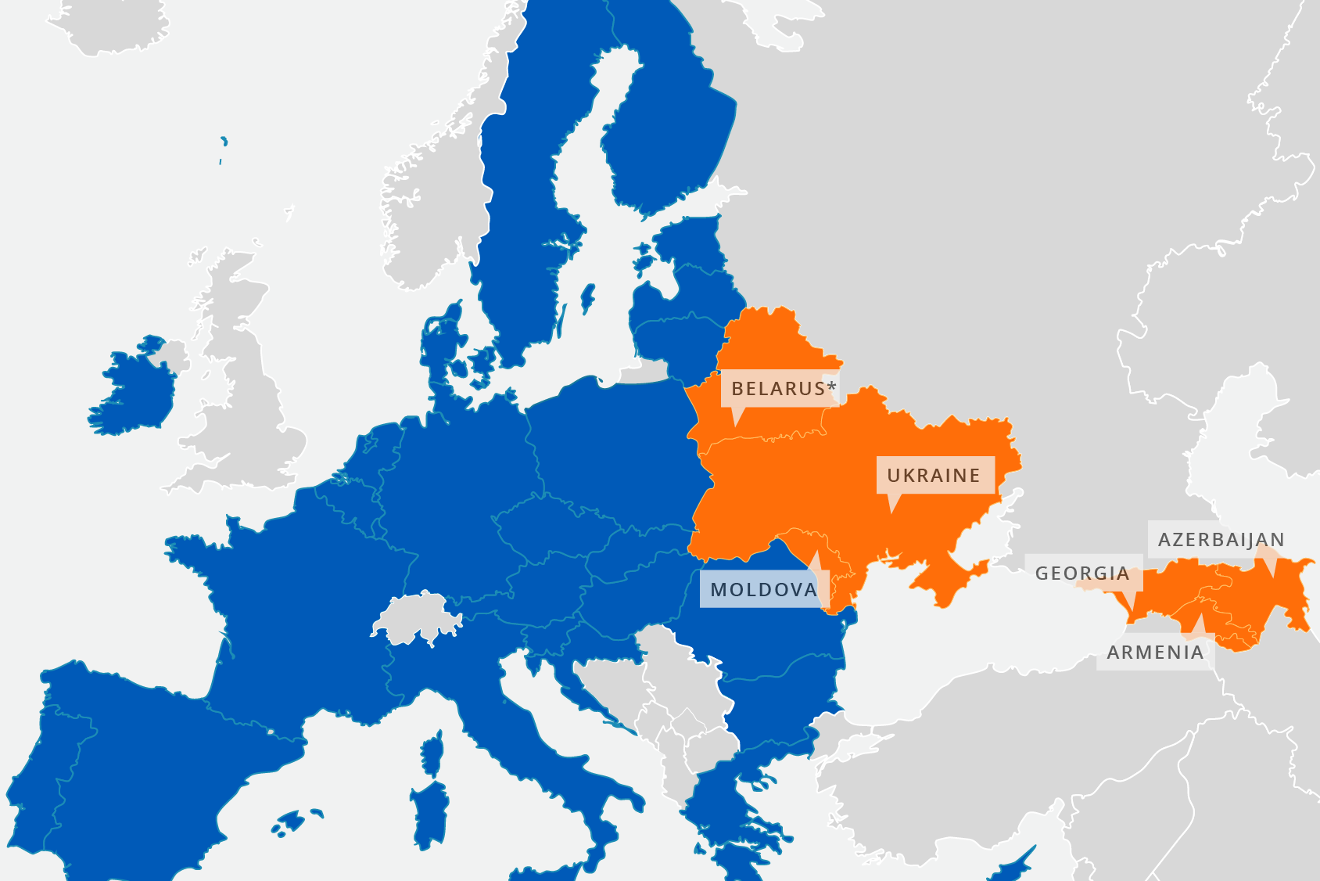
The Eastern Partnership: Stronger together

Slide 3
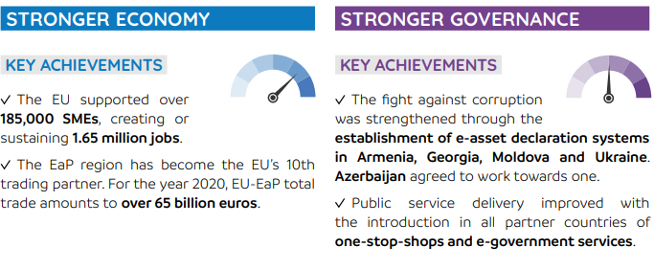
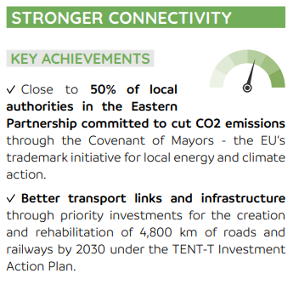
The Eastern Partnership: Bringing tangible benefits to citizens and businesses

Slide 4
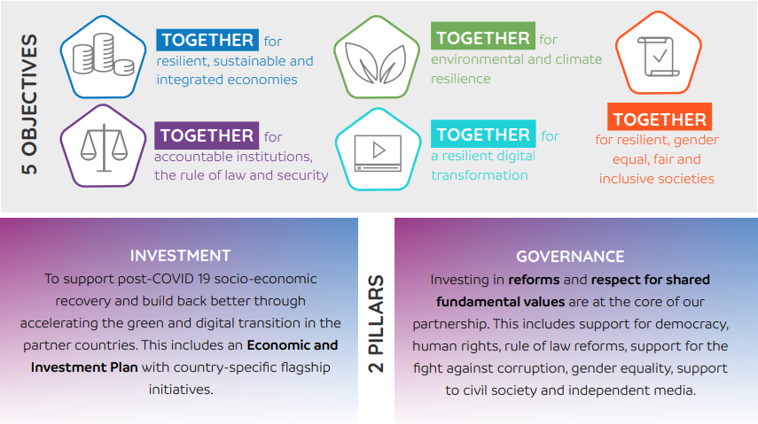
Recovery, resilience and reform: Post-2020 Eastern Partnership priorities

Slide 5
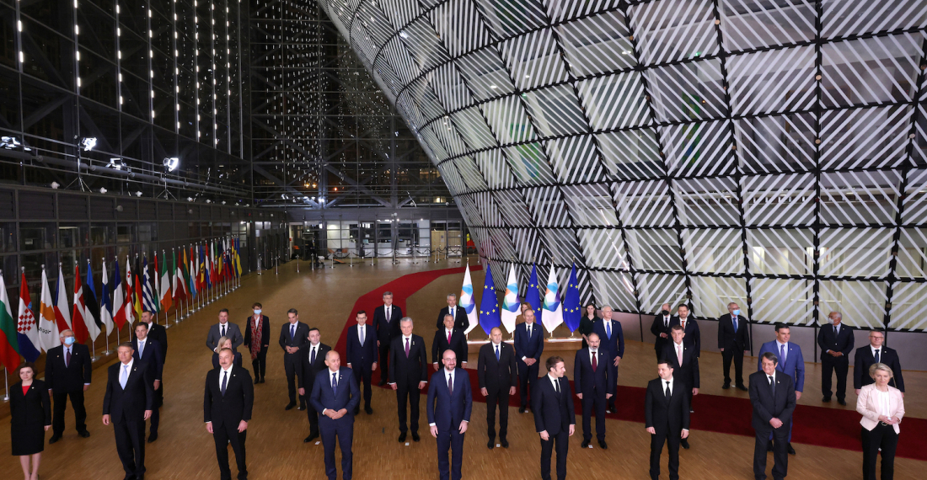
Thank you
© European Union 2022
Unless otherwise noted the reuse of this presentation is authorised under the CC BY 4.0 license. For any use or reproduction of elements that are not owned by the EU, permission may need to be sought directly from the respective right holders.
Notes:
Update/add/delete parts of the copy right notice where appropriate.
More information: https://myintracomm.ec.europa.eu/corp/intellectual-property/Documents/2019_Reuse-guidelines%28CC-BY%29.pdf

