Slide 1
Economic and Investment Plan for the Western Balkans
Webinar on European funding opportunities in Western Balkans
10 February 2022

Slide 2
Western Balkans

Slide 3
Economic and Investment Plan (EIP)
Response to ongoing COVID-19 crisis and spurring Western Balkan’s economic convergence with the EU, underpinned by green and digital transition.
New Western Balkans Guarantee facility, which can raise investments of up to € 20 billion.

Slide 4
Green Agenda for the Western Balkans
Informed by the European Green Deal
Embedded in the EIP
Endorsed by Western Balkans leaders at Sofia Summit
Forthcoming WB Agenda on Research, Innovation, Education, Culture, Youth and Sports
Focus on Human Capital, Digital Transformation & Green Deal
Supporting association to all EU programmes

Slide 5
Investment Windows and Investment Priorities
WBIF Intervention Areas
WB Guarantee Facility (EFSD+)
Investment Windows
WBIF Blending (public & private)
Investment priorities
Open architecture investment windows
EIB-dedicated investment window(s)
1. MSME finance
2. Connectivity: Energy, Transport and Digital
3. Sustainable Agriculture, Biodiversity, Forests and Water
4. Sustainable Cities
5. Sustainable Finance and Impact Investing
6. Human Development
1. Sustainable transport;
2. Clean energy;
3. Environment & climate;
4. Digital future;
5. Competitiveness of the private sector;
6. Human capital development.
1. Sovereign, and non-commercial sub-sovereign

Slide 6
The Western Balkans Investment Framework
WBIF will be the main instrument to deliver on the EIP
WBIF Blending
Investment Grants
WBIF public investment
Technical Assistance Grants
WBIF
WB Enterprise Development and Innovation Facility (EDIF)
Risk-sharing instruments
Guarantees for Infrastructure & SME support
WB Guarantee Facility

Slide 7
How does WBIF support works?
Blending Facility
Blended Finance
Equity
Public sector financing
IFI financing
Private Investors
EU support
Lead IFI
Financial
Intermediaries or
Governmental bodies
Beneficiaries

Slide 8
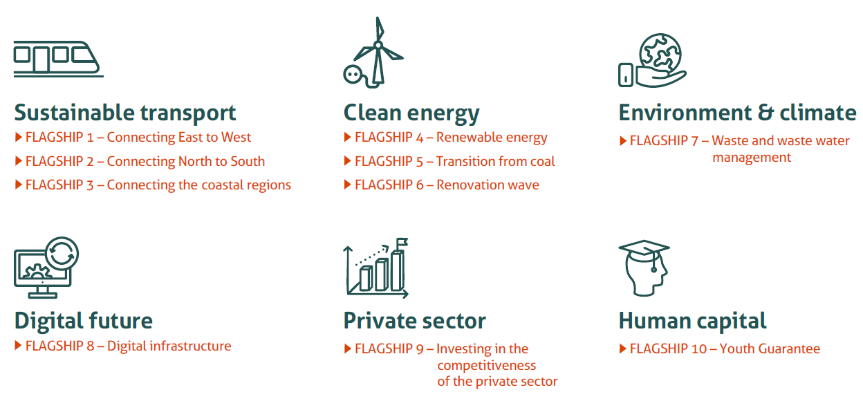
EIP Priorities & Flagships

Slide 9
PRIORITY 1 – Transport
Objective
Fast and efficient transport links, future-proof and sustainable, supporting the extension of the TEN-T, use of digital and clean green technologies
Key Components
Rehabilitation and construction Road and rail infrastructure, inland waterways
Deployment of digital transport technologies, such as intelligent transportation systems (ITS) or electronic queuing management systems (eQMS);
Road safety
Implementation of sustainable urban mobility, green multimodal transport solutions and investments intended to facilitate cross-border mobility.

Slide 10
PRIORITY 2 – Energy
Objective
Energy connectivity, decarbonisation, clean energy, digitalization of the system and smart grids, and energy security
Key Components
Decarbonisation and clean energy, harnessing renewable energy potential and transiting away from coal;
New digital technologies, increased digitalisation of the system and smart grids;
Promoting energy efficiency;
Energy security;
Enhanced energy connectivity.

Slide 11
PRIORITY 3 – Green Agenda
Objective
Decarbonisation, climate resilience, depollution of air/water/soil, green infrastructure, circular economy, sustainable farming/food production, protecting biodiversity
Key Components
• Upgrading basic infrastructure, greening the built environment, investments in climate-smart technologies and techniques in the field of solid waste management, water, sanitation, disaster preparedness, establishment of air and water monitoring systems and pollution prevention measures, and in the field of sustainable transformation of agri-food systems and rural development.
• Nature-based solutions will be encouraged and supported.
Notes:
I suggest starting with GAWB – even though not in order, it provides narrative for energy and transport too.

Slide 12
PRIORITY 4 – Digital Transition
Objective
Digital connectivity and access to digital infrastructures for citizens, businesses and education institutions with a focus on remote areas and to lower-income population
Key Components
Digital connectivity and access to digital infrastructures, with particular focus on remote areas and to lower-income population.
Investments in digital infrastructures should take into account the need to ensure infrastructure resilience and energy efficiency and the security of digital infrastructures should be improved;
Access to digital infrastructures for citizens, businesses and for education institutions, (including collaborative digital environments).

Slide 13
PRIORITY 5 – Private Sector
Objective
MSMEs support across green and digital transition, sustainable agriculture, trade and financial inclusion as well as financial/financing diversification and business climate
Key Components
Green transition; Sustainable agriculture; Digital transition and innovation; trade and value chains within the region and with the EU; Financial Inclusion; financial and financing diversification and Business climate development.

Slide 14
PRIORITY 6 – Human Capital
Objective
Unleash economic growth potential. Focus on digitalization, renewable energy and energy efficiency in infrastructures.
Key Components
Investments in new and/or upgraded facilities in the field of education (from early childhood education to high-level education), and health complying with clean energy, environmental protection, disaster resilience, including to climate change impacts, sustainable infrastructures and digitalization.
Investments have to incorporate and /or address the priorities of the digital and green agenda for the Western Balkans.
Investments have to be part of a country or regional education and health strategies and target explicitly inclusion of disadvantaged groups

Slide 15
Approved WBIF infrastructure projects to be tendered (1/2)
Country | Sector | Project | Total project cost (€)
Serbia | Digital | Rural Broadband Rollout Phase 2 | 106.450.000
North Macedonia | Energy | Oslomej 2 and Bitola Solar Photovoltaic Power Plants | 25.465.000
Serbia | Energy | Trans-Balkan Electricity Corridor: Obrenovac – Bajina Bašta Grid Section | 58.700.000
Bosnia and Herzegovina | Environment | Visoko Water Supply Project: Mostre Subsystem and Water Network Reconstruction Phase 3 | 8.250.000
Kosovo | Environment | Wastewater Treatment Plant and Sewerage Network Extension and Rehabilitation in Gjilan | 24.458.965
Kosovo | Environment | Wastewater Treatment Plant and Sewerage Network for Mitrovica | 31.172.180
Kosovo | Environment | Construction of Kremenate Dam: Detailed Design Update, Tender Dossier | 48.235.000
Montenego | Environment | Boka Bay Water Supply and Wastewater Collection | 25.002.825
Montenego | Environment | Bijelo Polje Wastewater Treatment Plant | 6.770.650
Montenego | Social | Construction of Mojkovac Prison Facility | 23.734.525

Slide 16
Approved WBIF infrastructure projects to be tendered (2/2)
Country | Sector | Project | Total project cost (€)
ALB | Transport | Mediterranean Corridor: Tirana Bypass | 190.652.506
ALB | Transport | Mediterranean Corridor: Vorë - Han i Hotit R2 Railway Line | 266.995.000
B&H | Transport | Rhine/Danube Corridor: Demining the Right Bank of the Sava River in Bosnia and Herzegovina | 38.000.000
B&H | Transport | Mediterranean Corridor: Medakovo – Ozimice Vc Motorway Subsection | 202.110.649
B&H | Transport | Mediterranean Corridor: Šamac – Doboj – Rječica Vc Railway Section | 162.512.000
KOS | Transport | Tender Documents and Supervision of Works for: Orient/East-Med Corridor: Kosovo – Serbia R7 Road Interconnection, Pristina – Merdare Section | 204.696.558
KOS | Transport | Orient/East-Med Corridor: Kosovo – Serbia R7 Road Interconnection, Pristina – Merdare Section | 204.696.558
KOS | Transport | Orient/East-Med Corridor: General Rehabilitation of Railway Route 10 in Kosovo, Signalling and Telecoms for Phase 1 and Phase 2 | 56.085.282
MK | Transport | Orient/East-Med Corridor: North Macedonia – Albania CVIII Road Interconnection, Bukojčani – Kičevo Subsection in North Macedonia | 136.548.914
MK | Transport | North Macedonia – Bulgaria CVIII Rail Interconnection: Kriva Palanka – Border with Bulgaria Section | 412.272.087
RS | Transport | Orient/East-Med Corridor: Serbia – Bulgaria CXc Rail Interconnection, Niš – Dimitrovgrad Section (Electrification and Signalling) | 55.777.000
RS | Transport | Orient/East-Med Corridor: Serbia – Kosovo R7 Road Interconnection, Niš (Merošina) – Pločnik (Beloljin) | 262.400.000

Slide 17
Thank you
© European Union 2020
Unless otherwise noted the reuse of this presentation is authorised under the CC BY 4.0 license. For any use or reproduction of elements that are not owned by the EU, permission may need to be sought directly from the respective right holders.
Slide xx: element concerned, source: e.g. Fotolia.com; Slide xx: element concerned, source: e.g. iStock.com
Notes:
Update/add/delete parts of the copy right notice where appropriate.
More information: https://myintracomm.ec.europa.eu/corp/intellectual-property/Documents/2019_Reuse-guidelines%28CC-BY%29.pdf

